Slide 1

Introduction to Web Development for Data Science

Slide 2
Overview of Web Development Basics for Data Science

Slide 3
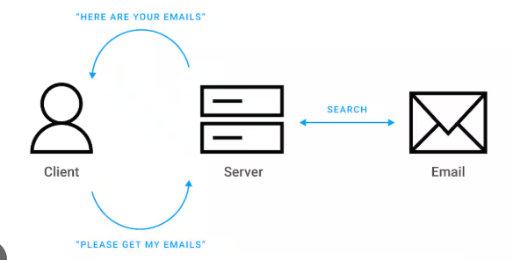
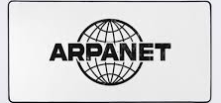

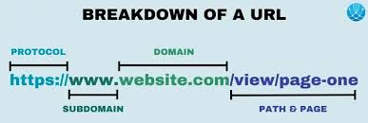
Basics of Web Development
Telephonic Network to ARPANET: The evolution from telephonic networks, which enabled voice communication, to ARPANET in the 1960s introduced packet-switching technology for data sharing between computers.
ARPANET to Internet and WWW: ARPANET expanded into the Internet, connecting global networks, while the World Wide Web (WWW) in 1989 provided a hyperlinked platform for accessing information online.
Client-Server Architecture: The WWW operates on a client-server model, where clients (browsers) send requests to servers hosting websites, enabling dynamic interaction and data exchange.

Slide 4
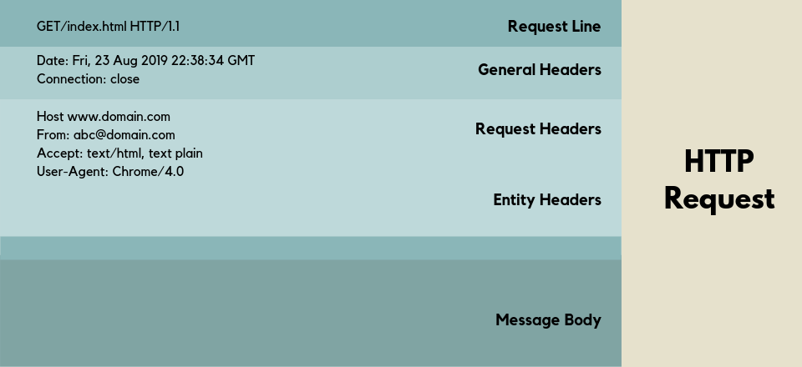

HTTP REQUEST
An HTTP request is a message sent by a client (such as a web browser) to a server, asking for a specific resource or action. It consists of a request line (HTTP method, URL, and version), headers (metadata about the request), and an optional body (data sent with methods like POST or PUT). This structure allows the server to process and respond with the requested content.

Slide 5
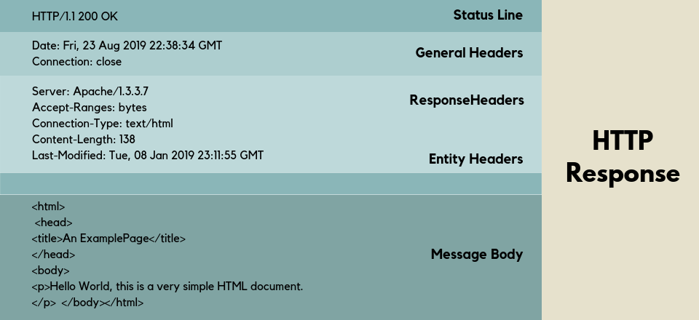

HTTP RESPONSE
An HTTP response is sent by the server to the client in reply to an HTTP request. It consists of a status line (HTTP version, status code, and message), headers (providing metadata like content type and length), and an optional body (containing the requested data or content). This structure enables the client to interpret the server's response and display the appropriate content.

Slide 6
HTTP METHODS
1. GET
Structure: GET /resource HTTP/1.1
Host: example.com
Explanation: The GET method retrieves data from the server. It is used for fetching resources such as web pages, images, or data from a database. GET requests do not modify any data on the server.
Use Case:
  Use GET when you want to retrieve data from the server without making any changes.
  Example: Retrieving a list of users from a database or fetching an HTML page.
2. POST
Structure: POST /resource HTTP/1.1
Host: example.com
Content-Type: application/json { "name": "John", "age": 30 }
Explanation: The POST method sends data to the server to create a new resource or trigger an action. It is often used to submit form data, create new records, or initiate server-side processes.
Use Case:
  Use POST when submitting form data or creating a new resource.
  Example: Creating a new user or posting a blog article.

Slide 7
HTTP METHODS
3. PUT
Structure: PUT /resource/1 HTTP/1.1
Host: example.com
Content-Type: application/json { "name": "John", "age": 31 }
Explanation: The PUT method is used to update an existing resource on the server.
It replaces the current representation of the resource with the provided data.
Use Case:
  Use PUT when you want to update an entire resource.
  Example: Updating a user's profile with new information, such as their age or name.
4. DELETE
Structure: DELETE /resource/1 HTTP/1.1
Host: example.com
Explanation: The DELETE method is used to remove a resource from the server. It is used to delete data or records.
Use Case:
  Use DELETE when you want to remove a resource.
  Example: Deleting a user from a database or removing a product from an online store.

Slide 8
HTTP METHODS
5. PATCH
Structure: PATCH /resource/1 HTTP/1.1
Host: example.com
Content-Type: application/json { "age": 32 }
Explanation: The PATCH method is used to partially update a resource. Unlike PUT, which replaces the entire resource, PATCH modifies only the specified fields.
Use Case:
  Use PATCH when you want to update only specific parts of a resource.
  Example: Changing a user’s email address or updating just the price of a product.
6. HEAD
Structure: HEAD /resource HTTP/1.1
Host: example.com
Explanation: The HEAD method is similar to GET, but it only retrieves the headers of a resource, not the body. It is useful for checking metadata like content type, length, or last-modified time without downloading the entire resource.
Use Case:
  Use HEAD to check if a resource exists or to retrieve metadata (like checking if a file has changed).
  Example: Checking if a resource is available or verifying the size of a file.

Slide 9
HTTP METHODS
7. OPTIONS
Structure: OPTIONS /resource HTTP/1.1
Host: example.com
Explanation: The OPTIONS method is used to request information about the communication options available for a resource. It returns the allowed HTTP methods (GET, POST, PUT, etc.) for a specific resource.
Use Case:
  Use OPTIONS to discover what HTTP methods are supported by a resource.
  Example: Before making a cross-origin request, checking which methods the server supports.

Slide 10
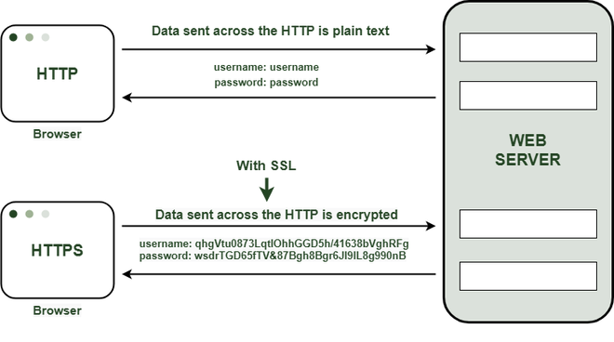
HTTPS
HTTPS (Hypertext Transfer Protocol Secure) is a protocol used for secure communication over the internet. It encrypts data exchanged between a client (browser) and a server using TLS (Transport Layer Security), ensuring privacy, data integrity, and authentication. The server’s SSL certificate, signed by a trusted Certificate Authority (CA), enables encryption and establishes trust. This protects against eavesdropping, tampering, and man-in-the-middle attacks, making online communication secure.

Slide 11
Role of APIs in Data Science

Slide 12
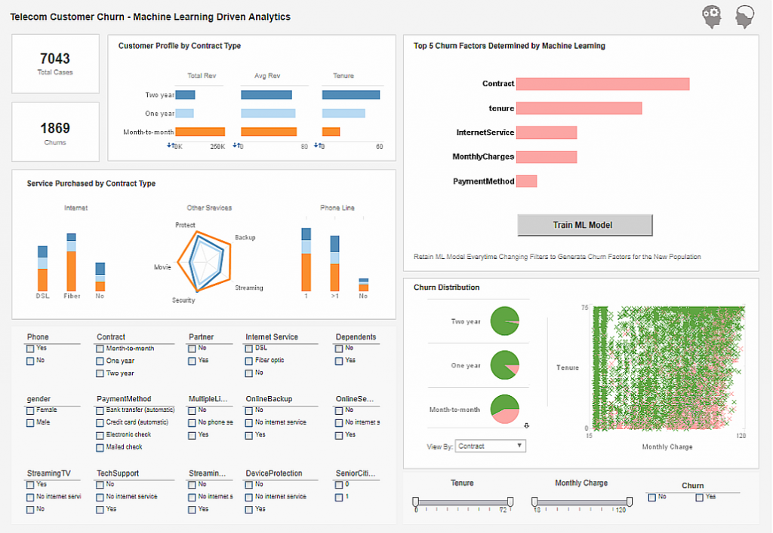
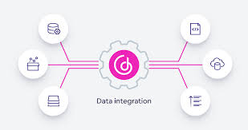
Role of APIs in DS
Real-time Predictions:
APIs allow data scientists to deploy machine learning models and expose them as services, enabling real-time predictions. This is crucial for applications such as recommendation systems, fraud detection, or dynamic pricing models.
Data Integration:
APIs enable seamless integration of external data sources, such as databases, cloud platforms, or third-party services (e.g., social media, weather, financial data), which is essential for gathering diverse datasets needed for analysis and model building.

Slide 13
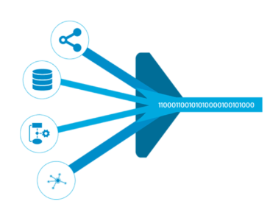
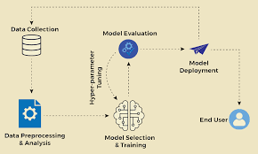

Role of APIs in DS
Automation of Data Pipelines:
APIs automate the process of data retrieval, preprocessing, and feeding data into machine learning models, helping streamline workflows and save time. This ensures that the data science process is efficient and reproducible.
Model Deployment:
APIs provide a way to deploy machine learning models in production, making them accessible via endpoints for various applications or services. This is key for deploying predictive models in real-world scenarios.
Collaboration and Sharing:
APIs enable sharing of data, models, and services across teams or organizations, promoting collaboration in data science projects. It allows easy access to shared resources and fosters innovation through shared tools and datasets.

Slide 14
Thank You!

